Slide 1

Price Analysis On Mobiles (By using Web Scraping & Exploratory Data Analysis)
Presented By :
Maradapu Charishma

Slide 2
I’m Maradapu Charishma. I have done my Masters in computer Applications(MCA). My enthusiasm in IT sector lead me to choose Data Science as my career path to upskill myself
No prior work experience till date.
About Me

Slide 3
Problem statement :
To conclude which mobile is suitable according to their budget , features.
Objective :
Based on analysis, I can conclude that which brand is in the trend and can suggest according to their needs, which feature is affecting the price to increase or decrease
Website :
Flipkart

Slide 4
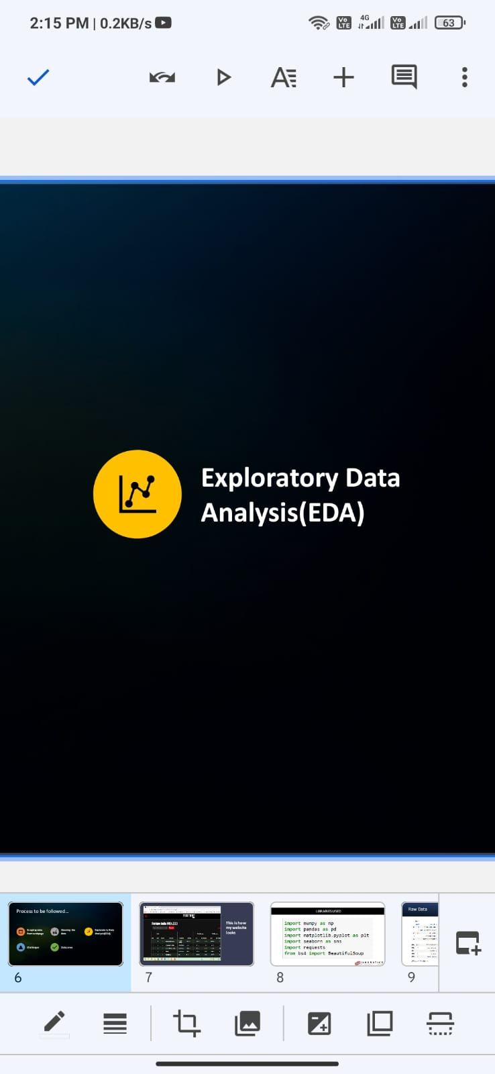

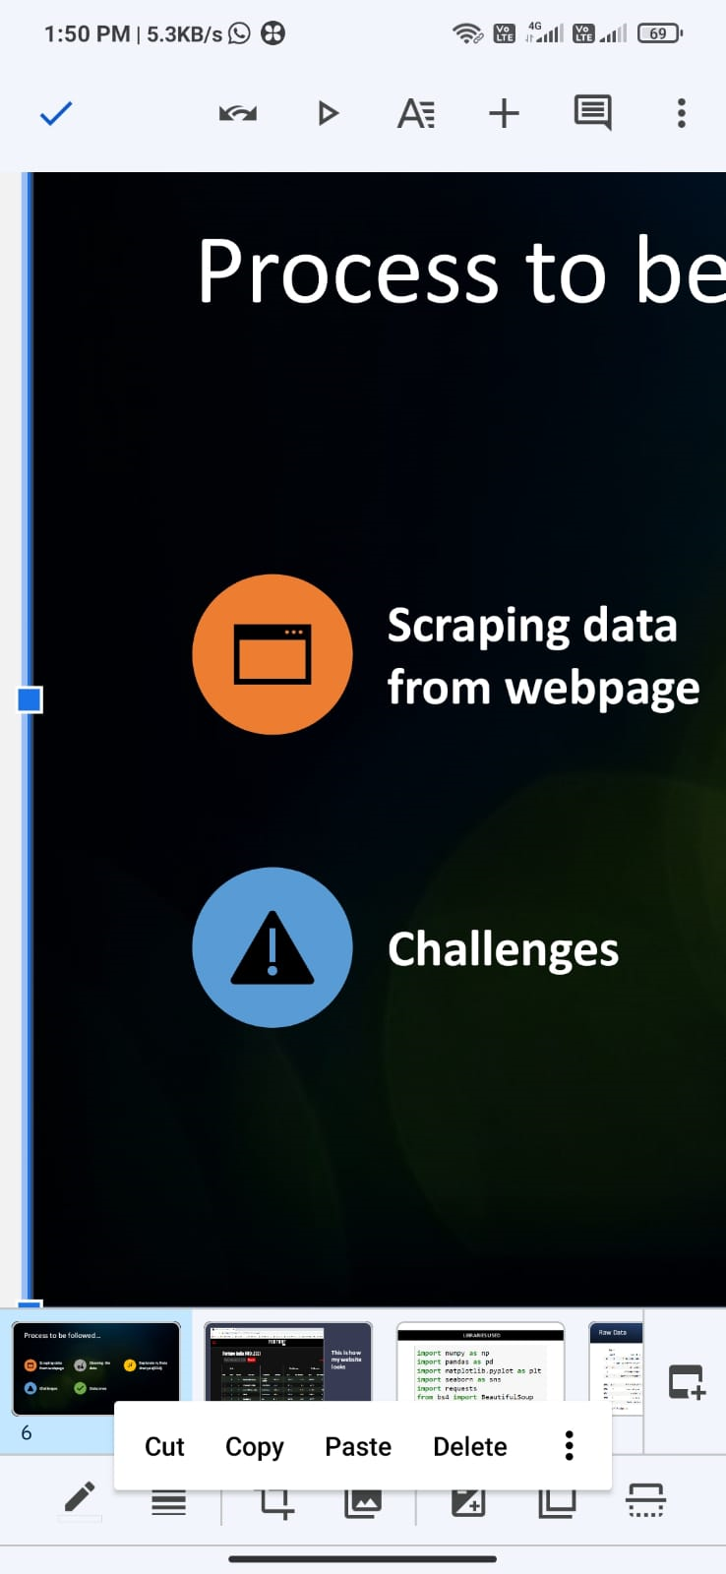


Work Flow :
Exploratory Data Analysis
Extracting The
Data Using
Regex
Scraping Data From Webpage
Cleaning The Data
Challenges &
Outcomes

Slide 5
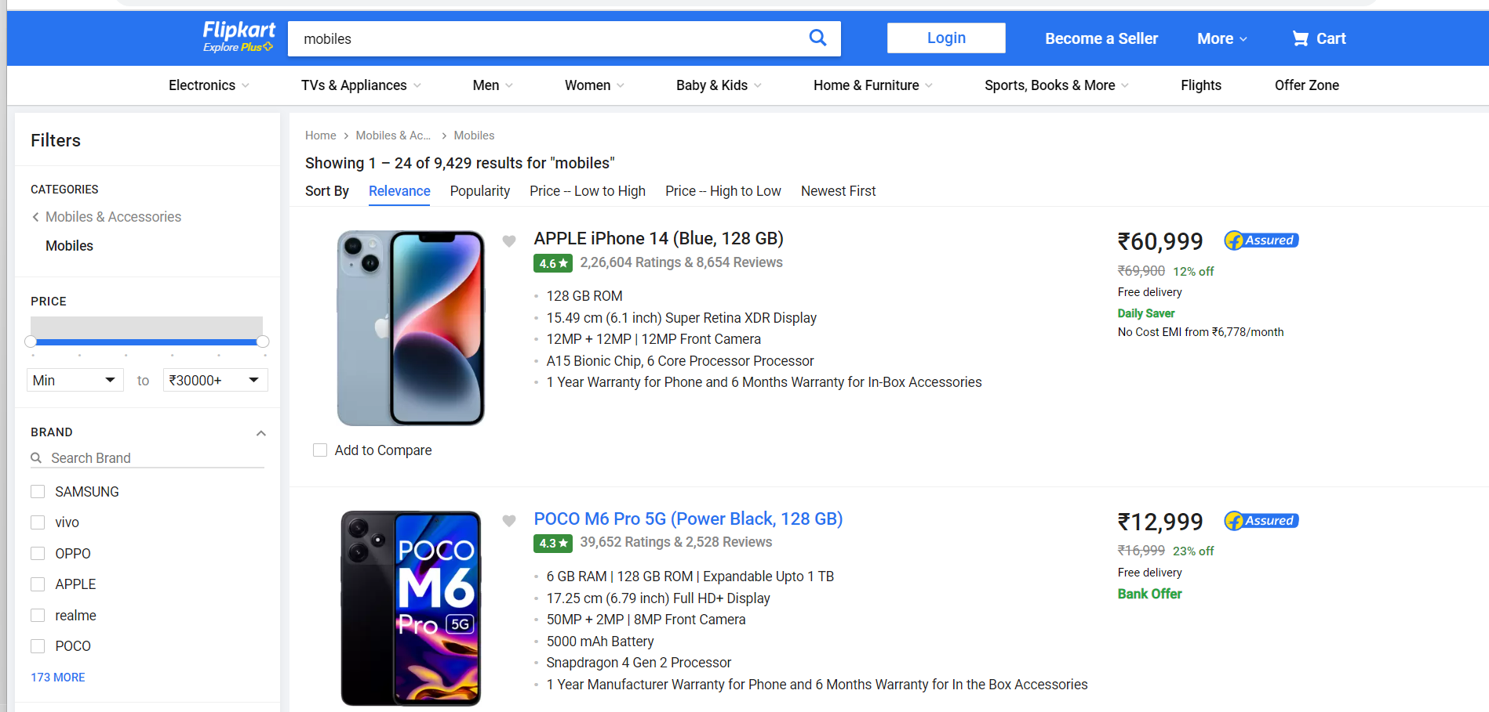
Website we used to scrap the data

Slide 6
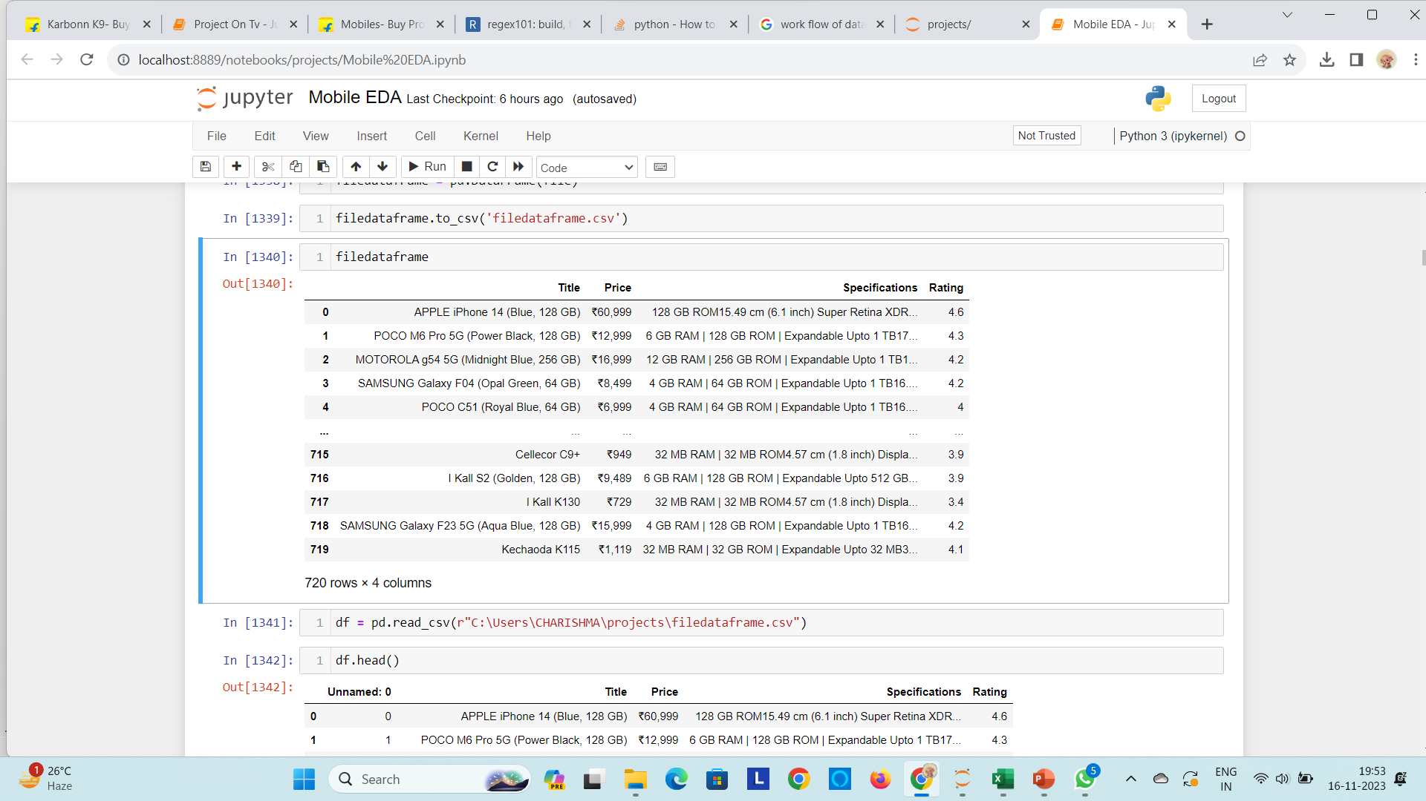
After Scraping - Raw Data

Slide 7
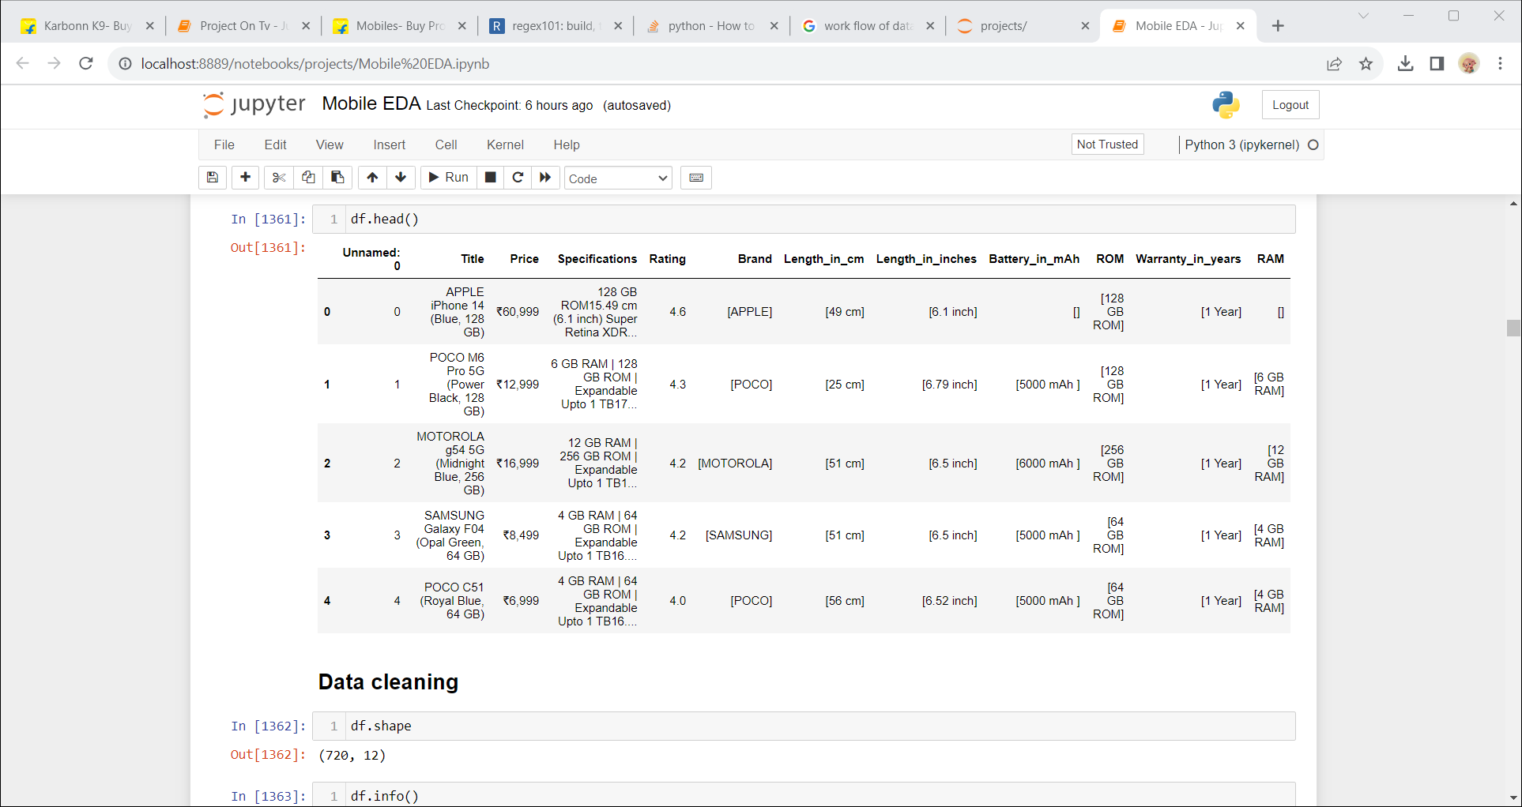
Regular Expression
By using regex we extracted the details/data and put them into different columns

Slide 8






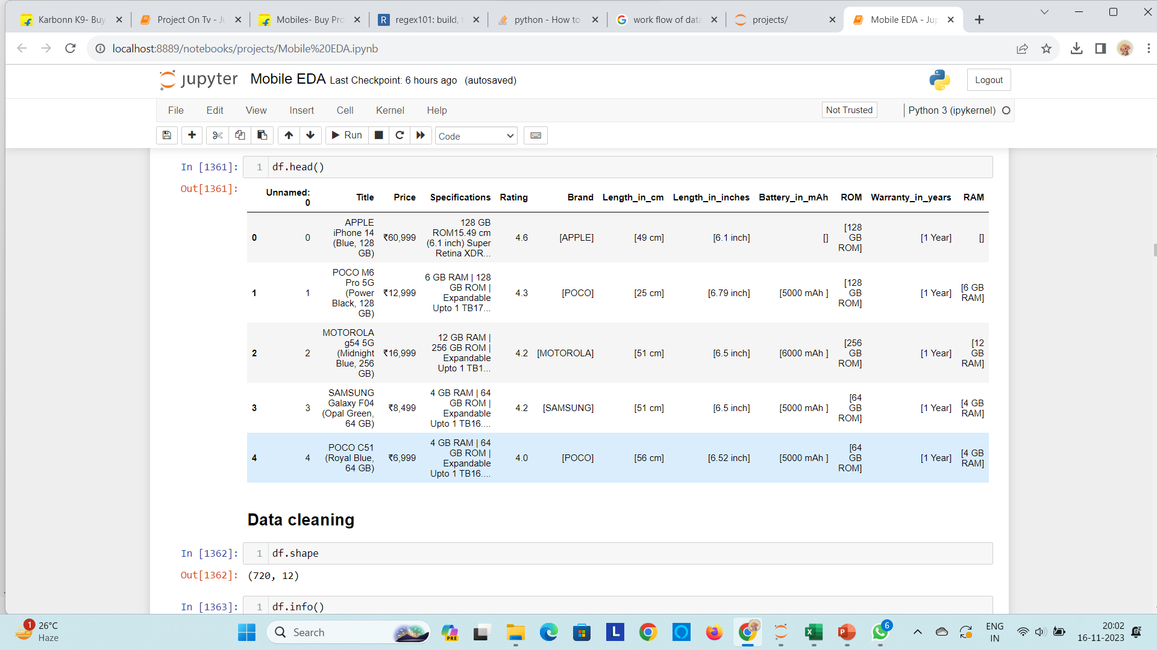
Cleaning The Data
06
Replaced the nan values using Domain knowledge
01
03
Remove rows & columns
Put the columns
In an
order
05
Converted the list data into str data
04
02
Replacedunwanted things
Rename the columns

Slide 9
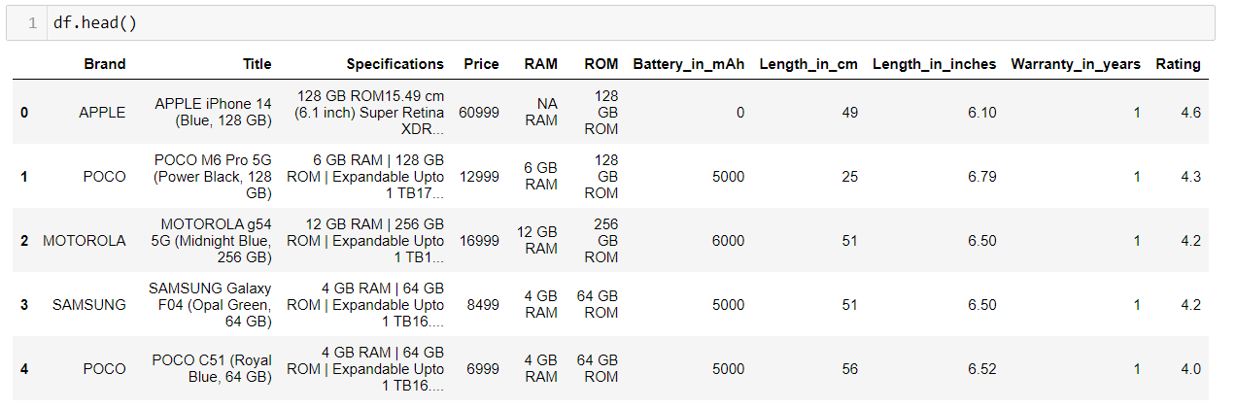
My Final Data
After cleaning everything this is the final data

Slide 10
Exploratory Data Analysis

Slide 11
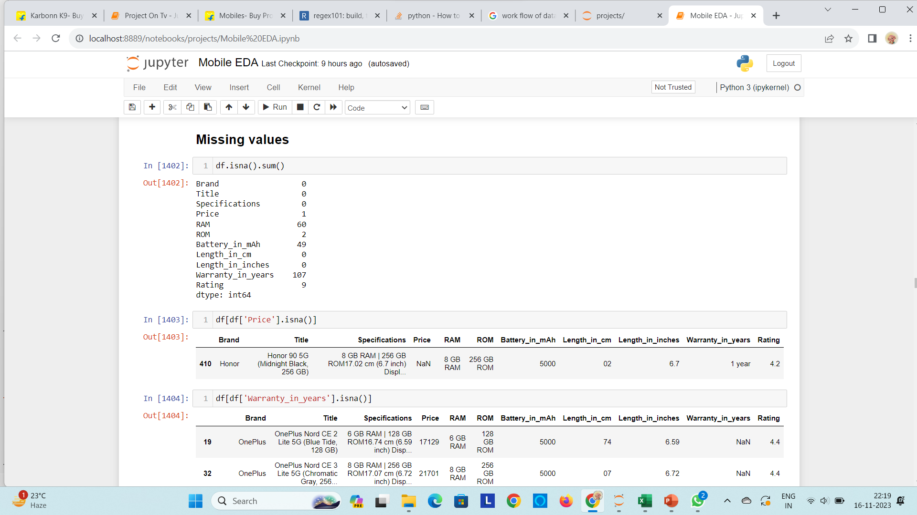
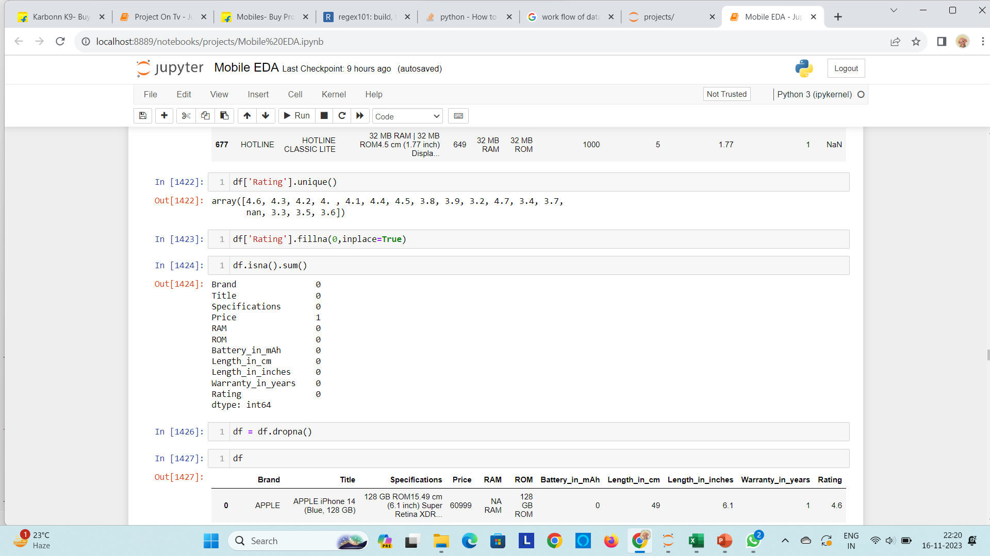
Handling The Missing Values
We replaced the nan values
using Domain knowledge
This is the output after replacing all NaN values.

Slide 12
The graphical analysis is the method of analysis which perform graphing by taking the input from the data frame.
Univariate Analysis
Bivariate Analysis
Multivariate Analysis
Graphical Analysis

Slide 13
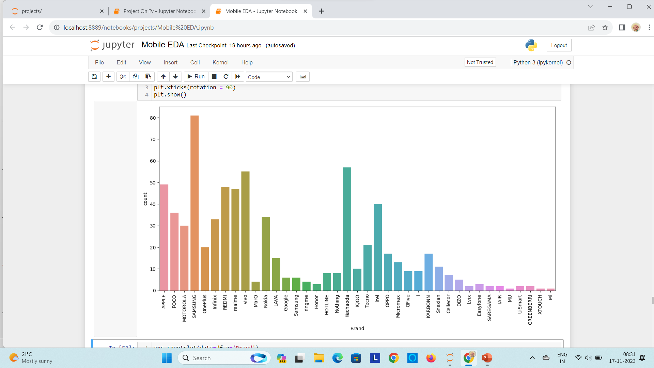
Univariate Analysis
This is a count plot for visual comparsion of all brands.
In this count plot ,we can see that max number of mobiles in my data frame are Samsung brands and minimum are MU, XTOUCH, Mi etc.,

Slide 14
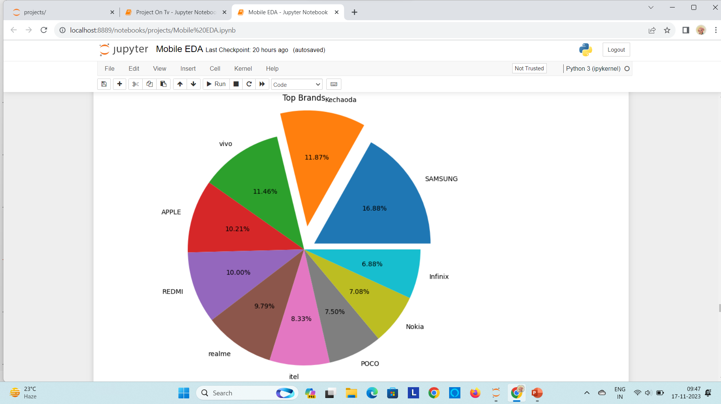
Top Brands
This are the top brands that customers are more interested to purchase.

Slide 15
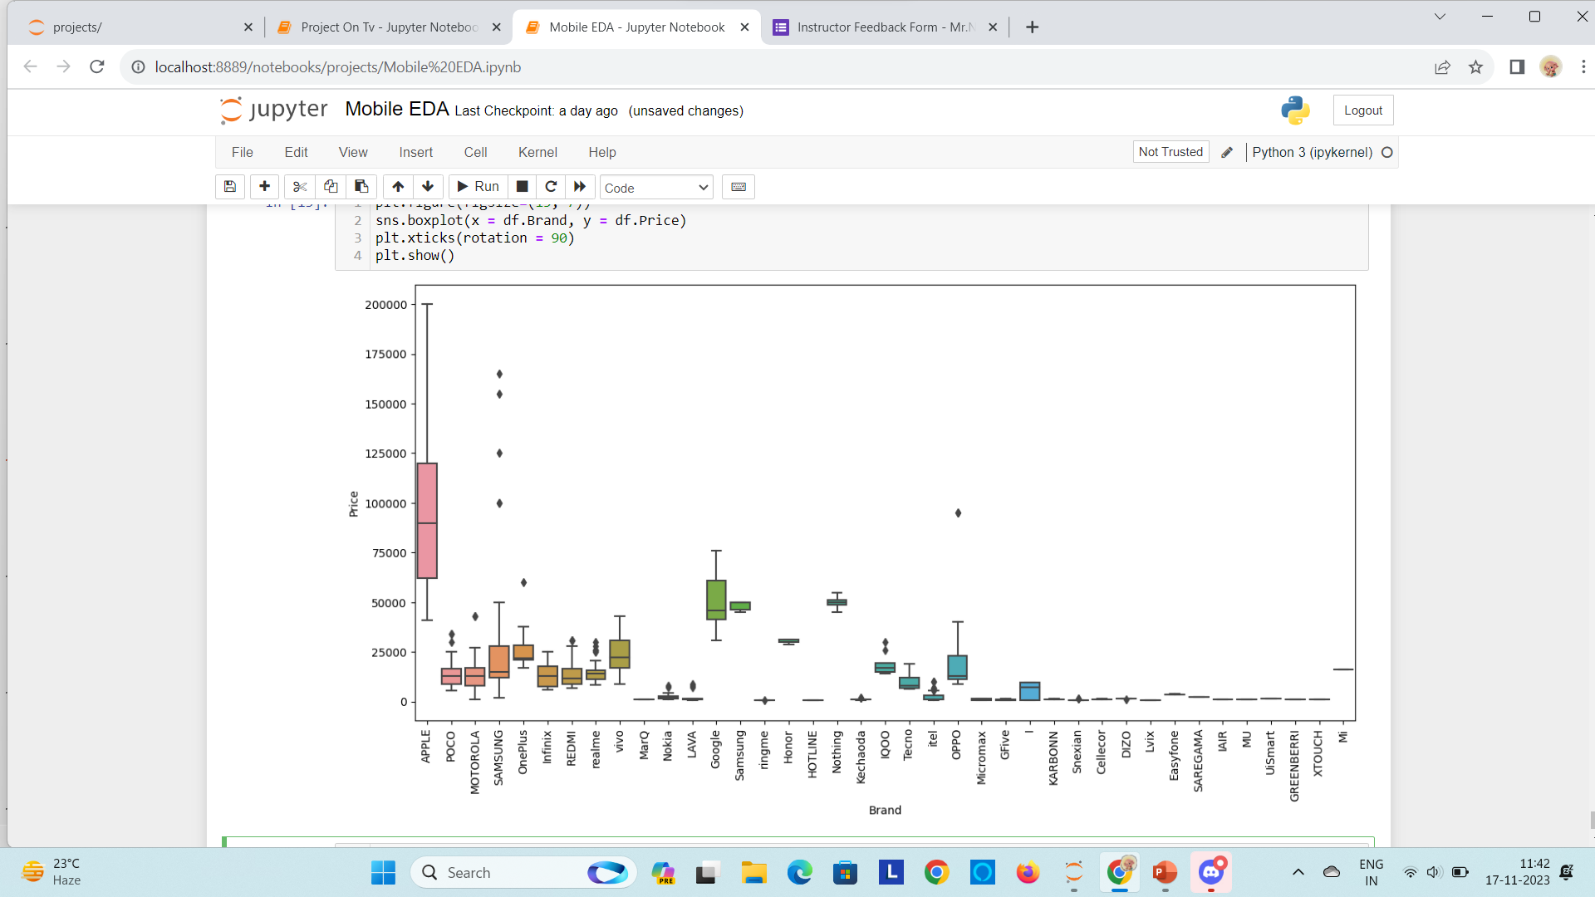
Bi-variate Analysis
This is a boxplot of Brands and It’s Prices :
This boxplot is showing us the outliers existing in our data frame.

Slide 16
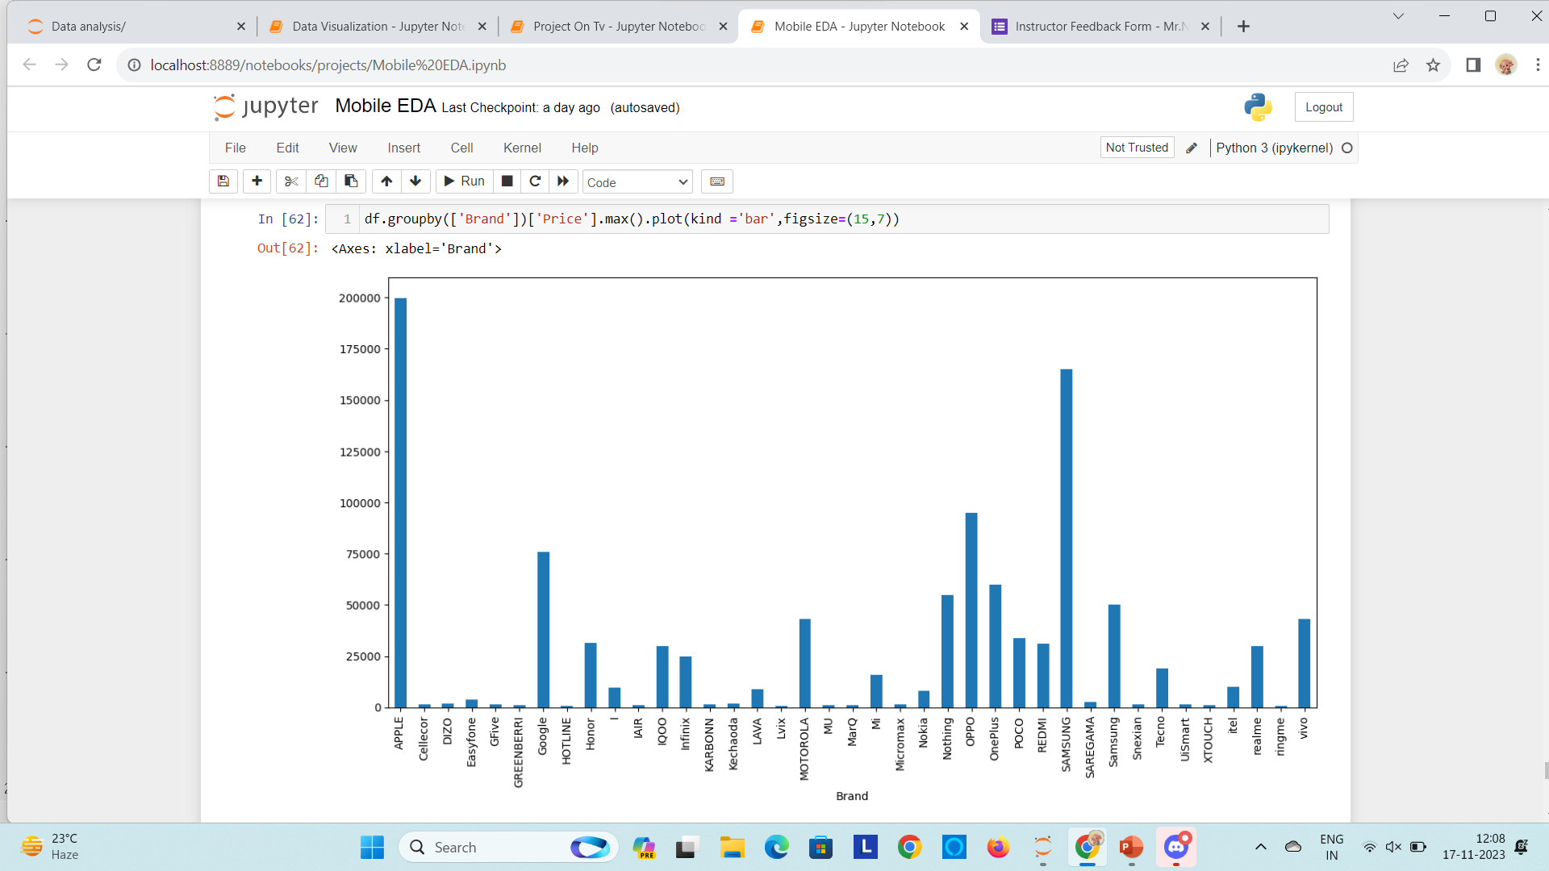
This is a bar plot of Brands and It’s Prices :

Slide 17
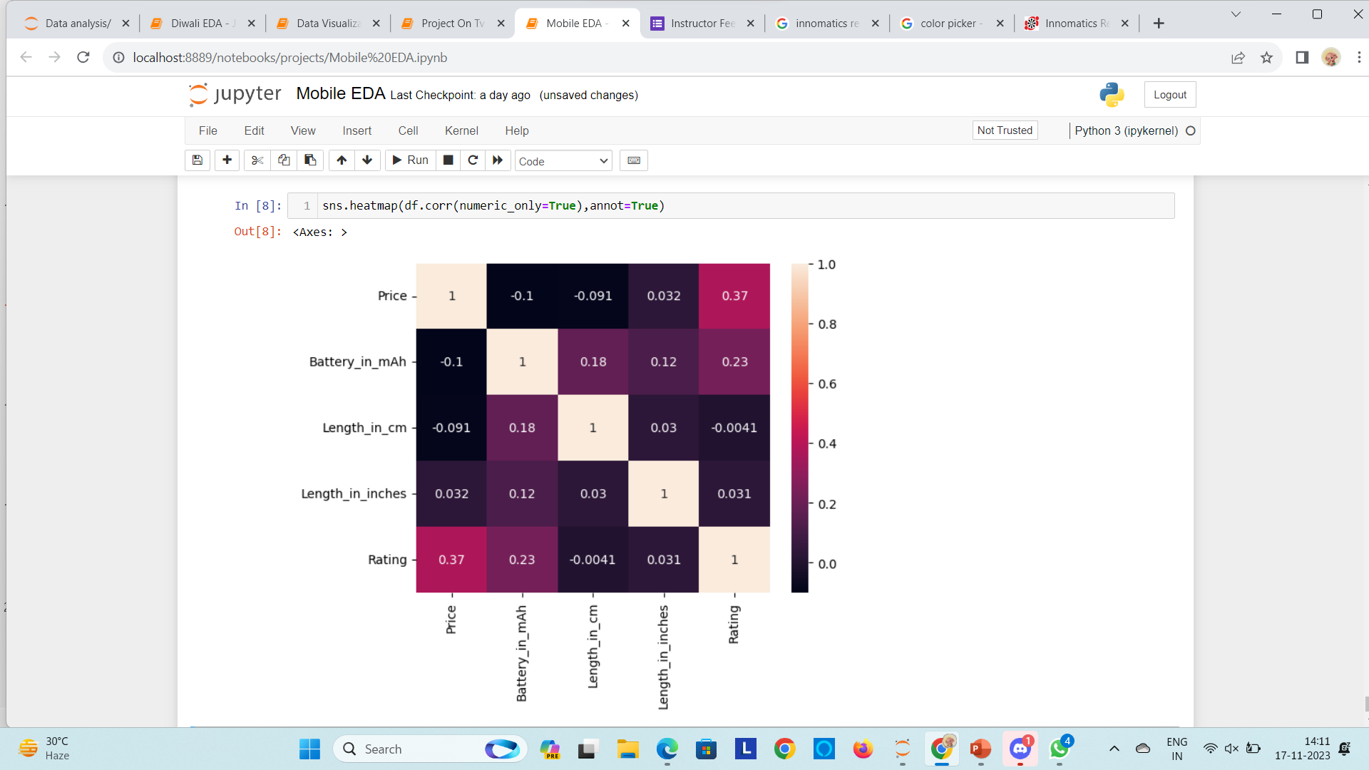
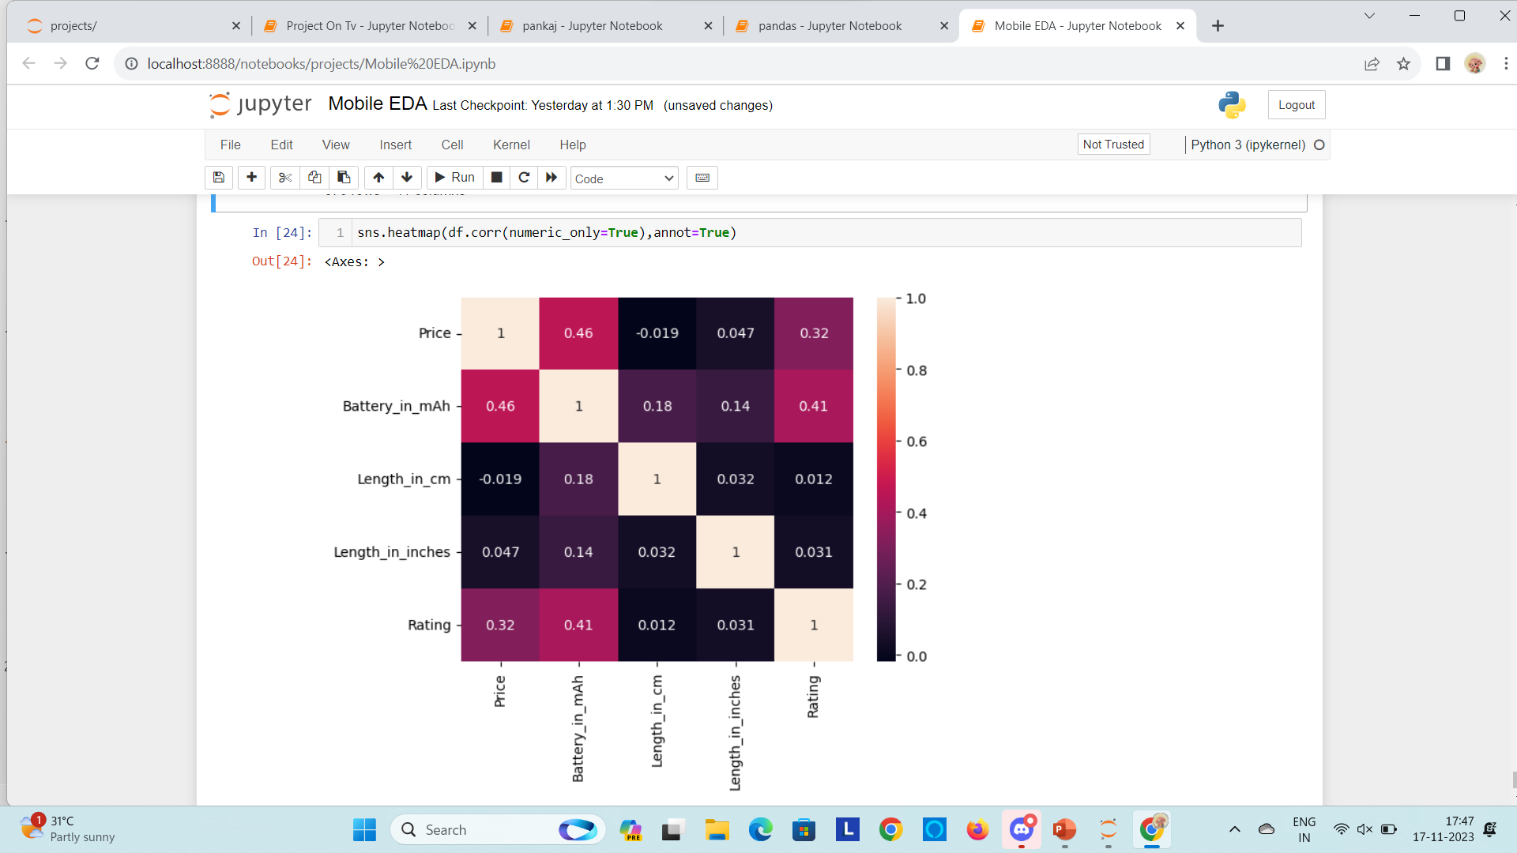
Multi-variate Analysis
Correlation Between Numerical Features

Slide 18
One of the challenges i faced while extracting the data by using regex.
Replacing the null values with accurate data is another challenge we’ve faced.
Challenges
In this project we have analysed about the mobiles that are available to buy across india.
From the analysis we understand that customers bought most of the mobiles from Samsung brand.
From the analysis we understand that customers showing low interest in these MU,XTOUCH,Mi Brand.
Outcomes

Slide 19

THANK YOU

